Slide 1












Aquamarine
Kelompok 6 :
Gloria Valerie Lao - 535200049
Michelle Augustine - 535200055
Tiffany - 535200057
Fundroo Orlando - 535200074
Stevenson Tjuaca- 535200067

Slide 2


01
5W + 1H

Slide 3


What ?
Seafood Online Shop
Website yang akan kami buat bernama Aquamarine yaitu merupakan suatu online shop yang dapat mengorder item-item seafood dari perusahaan kami

Slide 4

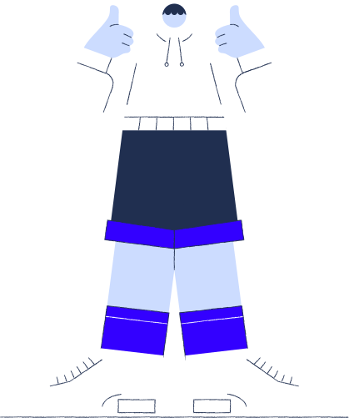

Who ?
Website ini ditujukan secara langsung kepada para pecinta seafood agar dapat memenuhi keinginan mereka saat pandemi ini.

Slide 5



Where ?
Nama Perusahaan : Aquamarine
Lokasi : Jakarta Barat, Indonesia
Website : aquamarine.com

Slide 6
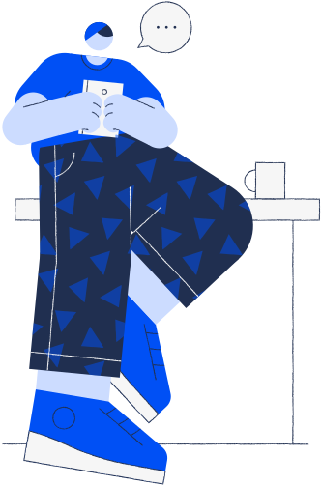

When ?
Pembuatan web ini dimulai dari bulan Agustus 2021 dan akan selesai pada bulan Desember 2021

Slide 7

Why ?
Kami memilih topik ini dikarenakan untuk membantu masyarakat memenuhi kebutuhannya, khususnya dalam bidang pangan seperti ingin menikmati aneka seafood tanpa harus keluar untuk membeli di tengah situasi pandemi saat ini

Slide 8


How ?

Slide 9

BERJALAN SECARA
ONLINE
01
PEMESANAN
02
Pemesanan melalui web
Sistem pemesanan adalah sistem Pre-Order (PO)
PEMBAYARAN
03
PENGIRIMAN
04
Transfer via e-money atau COD
Menggunakan box styrofoam dengan es

Slide 10

02
Rencana Fitur dan Layout

Slide 11

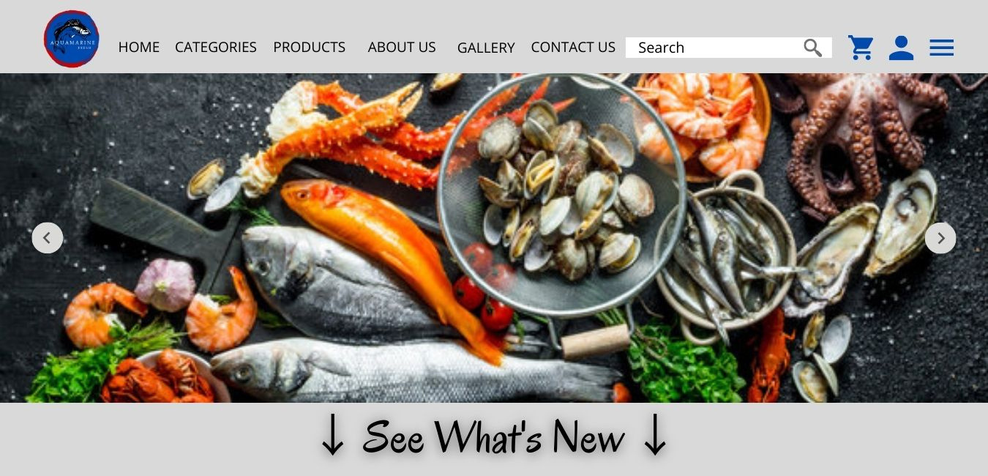
Halaman Home

Slide 12
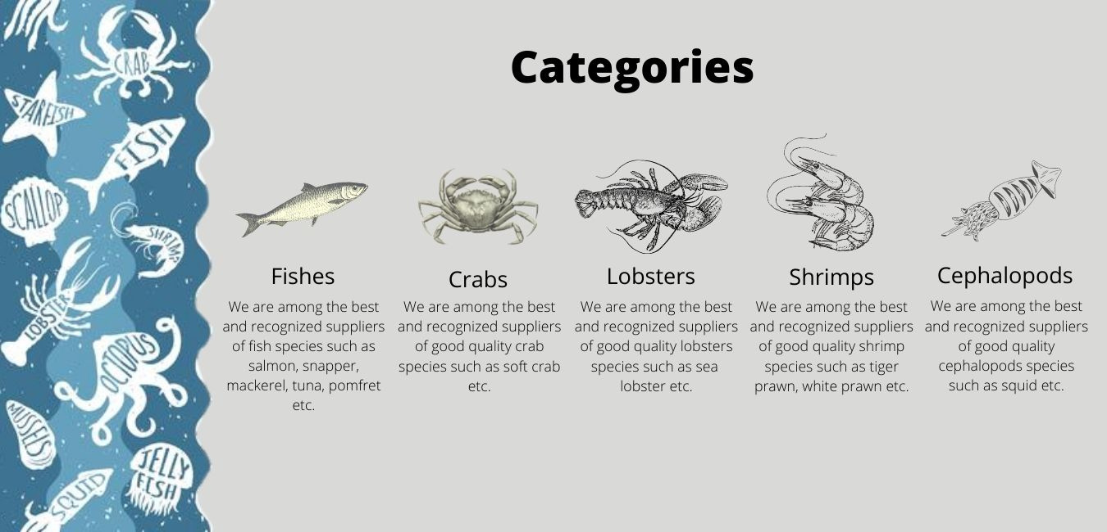
Halaman Categories

Slide 13
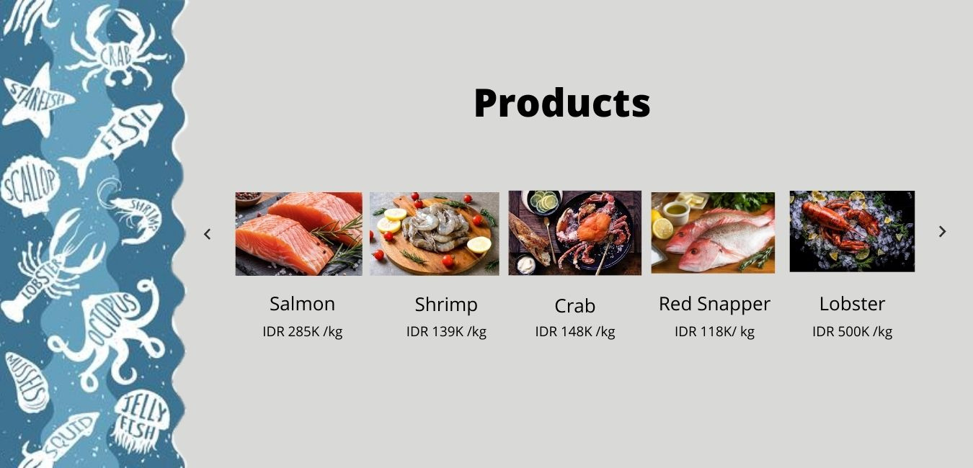
Halaman Products

Slide 14
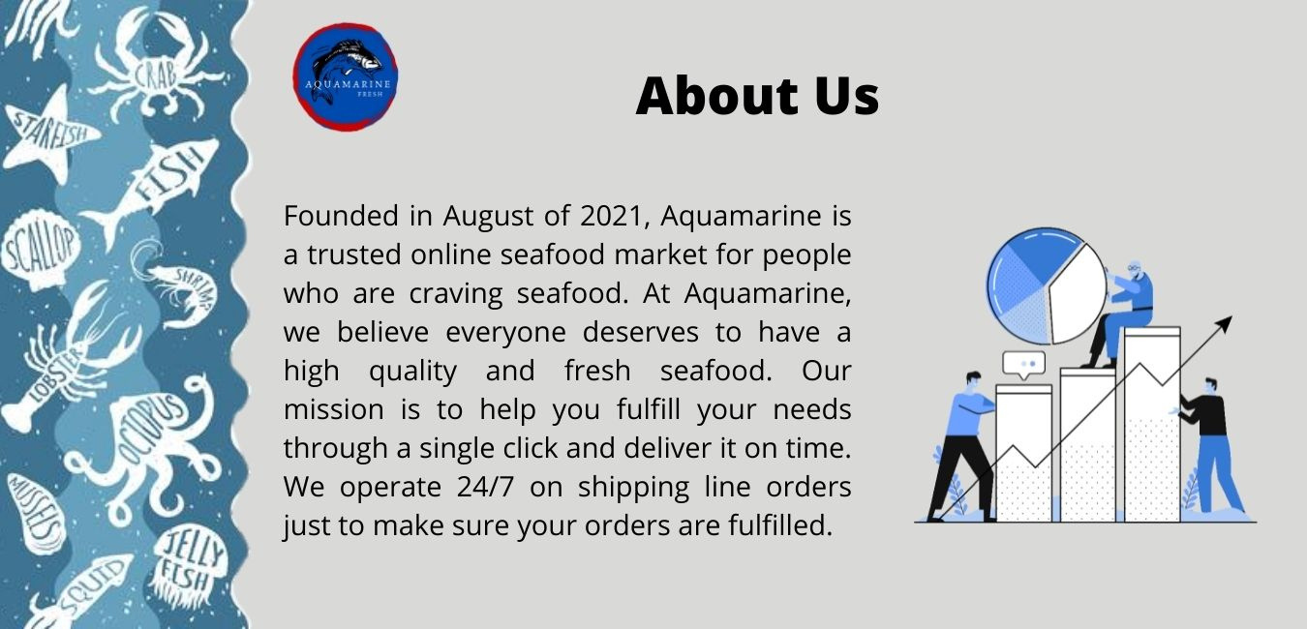
Halaman About Us

Slide 15

Halaman Gallery

Slide 16


Halaman Contact Us

Slide 17
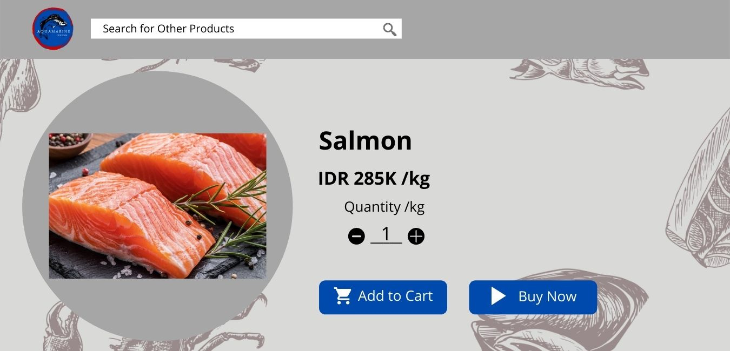
Halaman Product Details

Slide 18
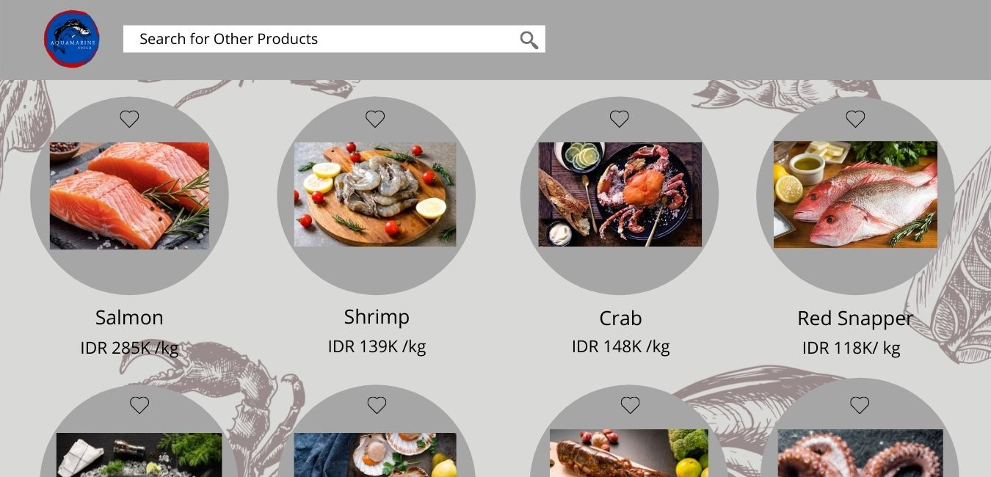
Halaman Products List

Slide 19
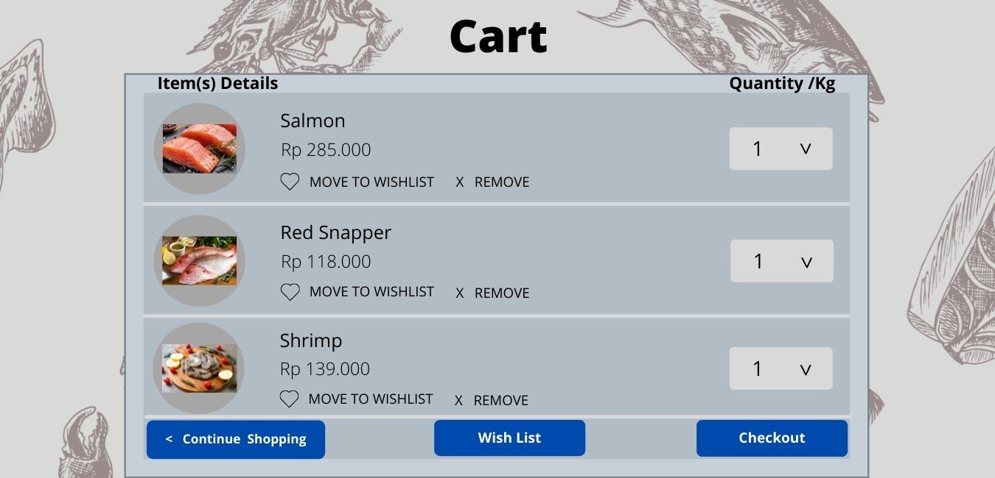
Halaman Cart

Slide 20

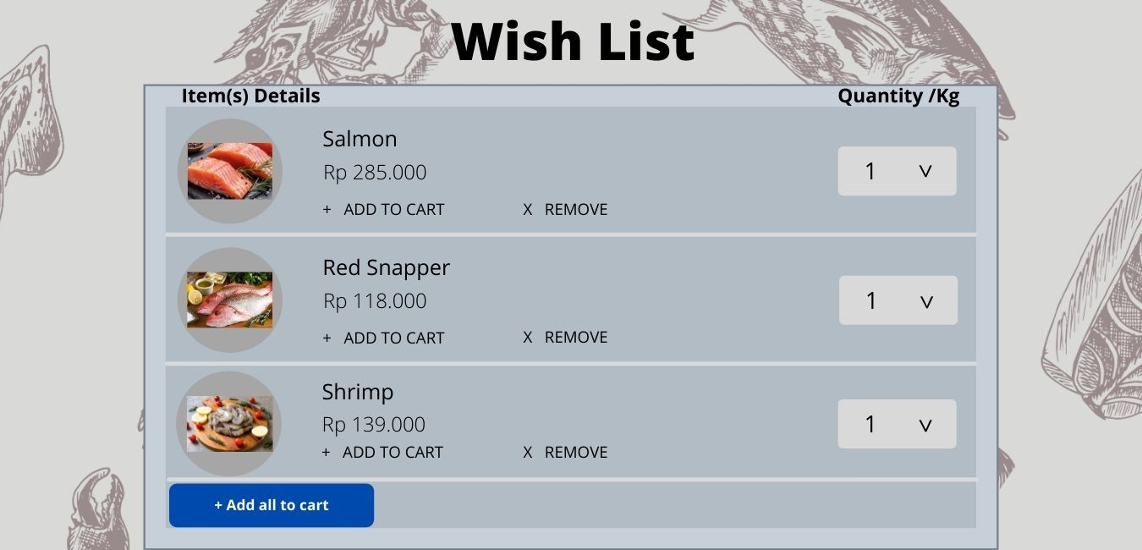
Halaman Wish List

Slide 21
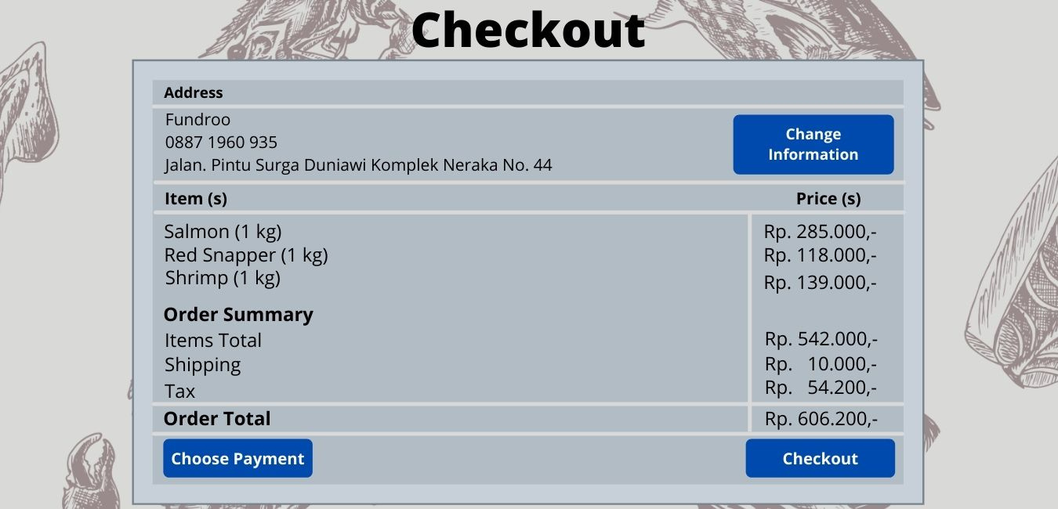
Halaman Checkout

Slide 22
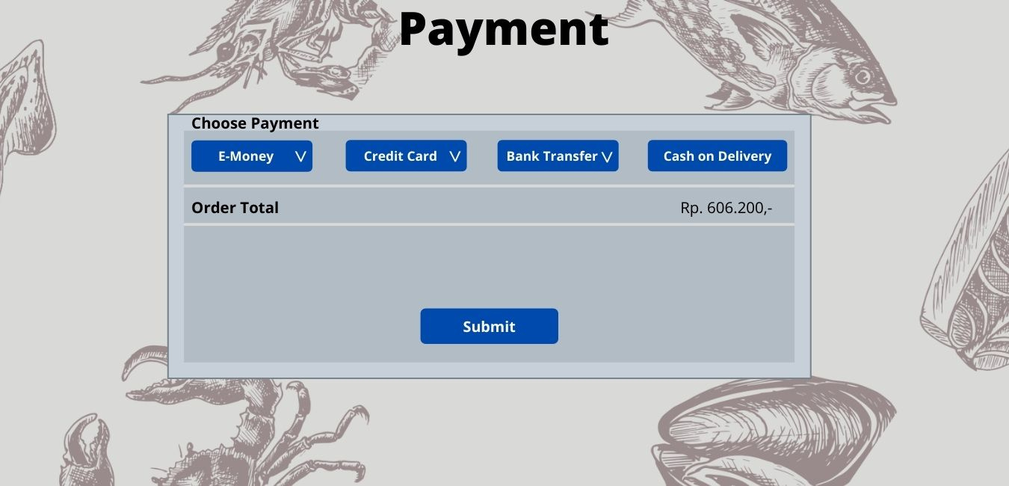
Halaman Payment

Slide 23
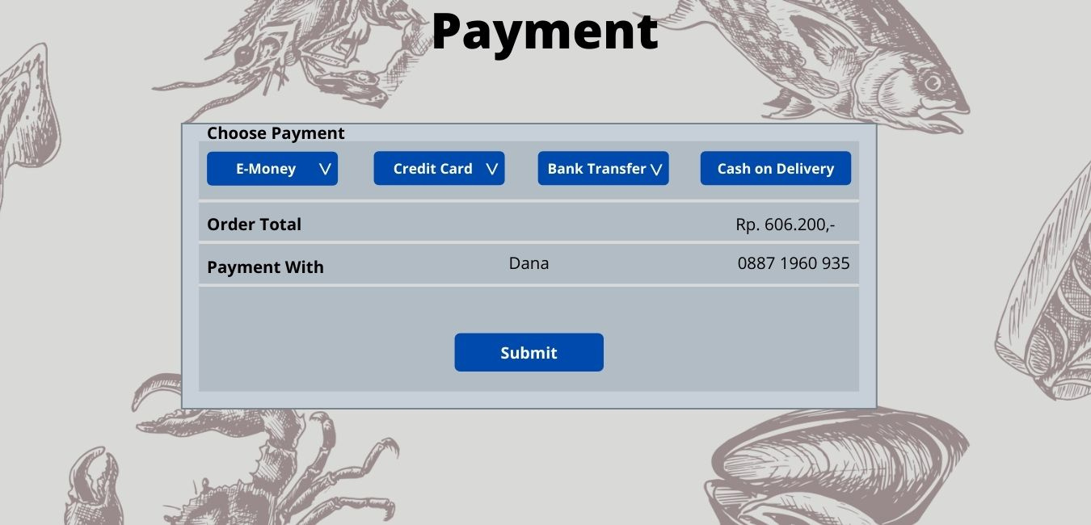
Halaman Payment

Slide 24
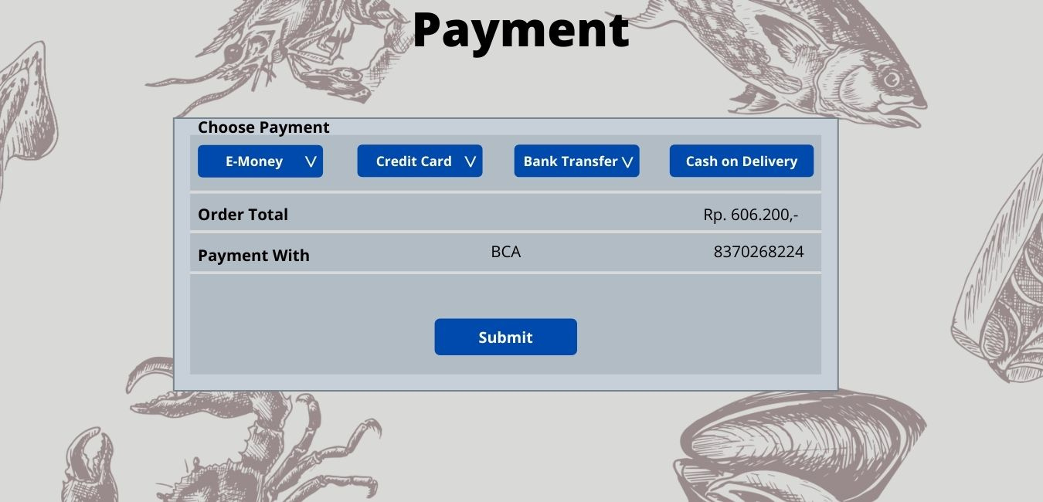
Halaman Payment

Slide 25

Halaman Payment

Slide 26
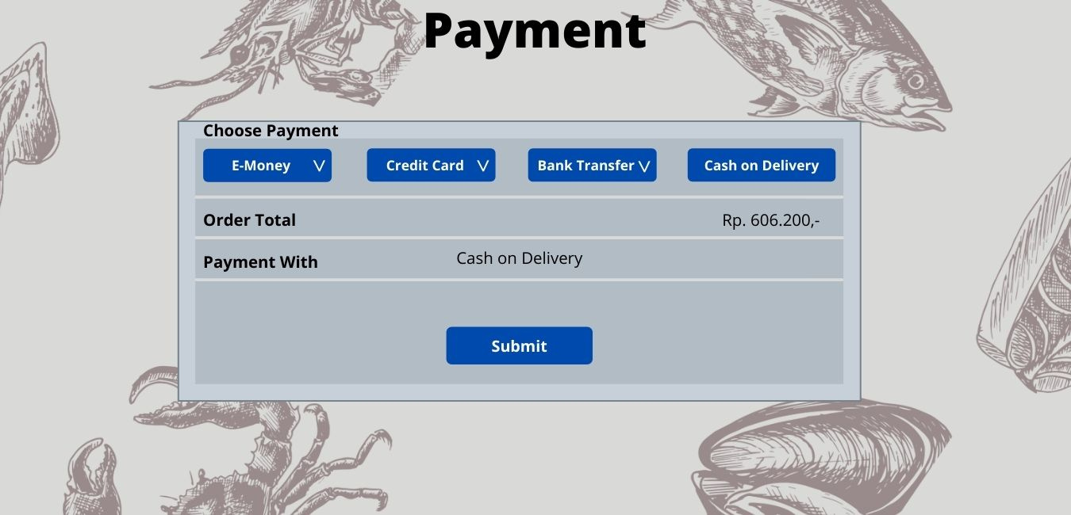
Halaman Payment

Slide 27
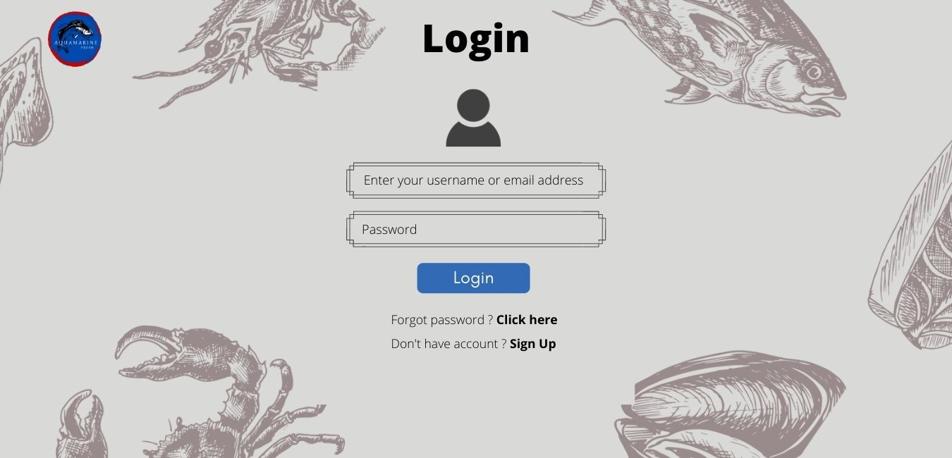
Halaman Login

Slide 28
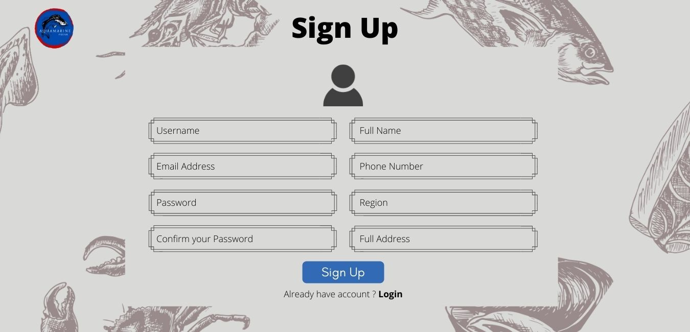
Halaman Sign Up

Slide 29
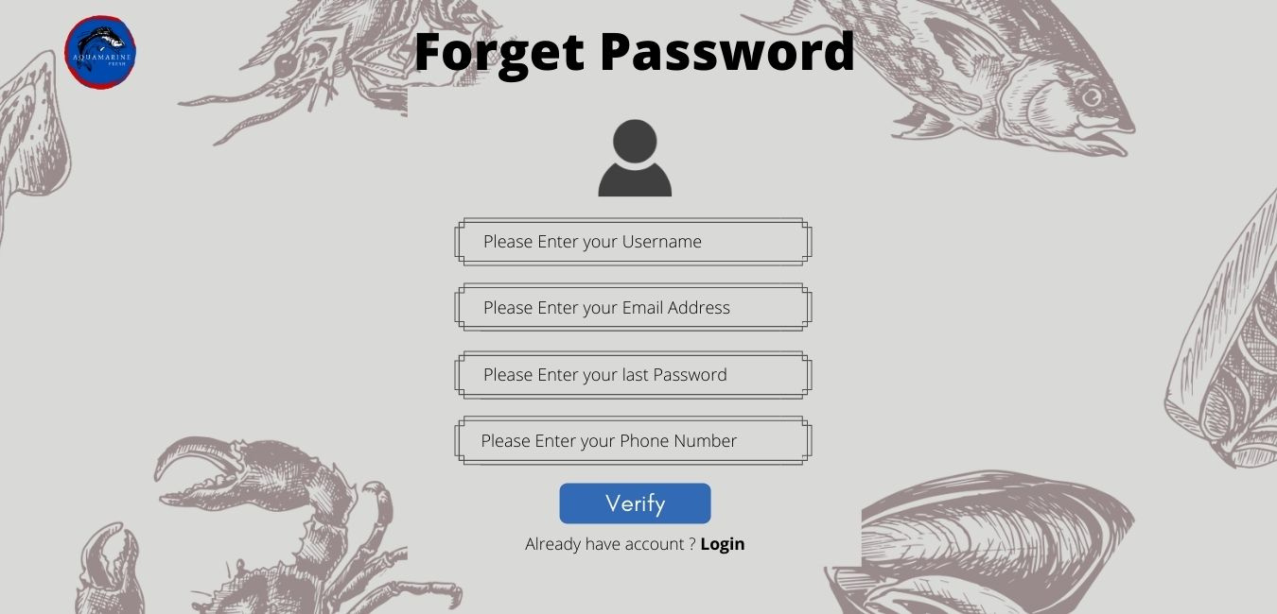
Halaman Forget Password

Slide 30
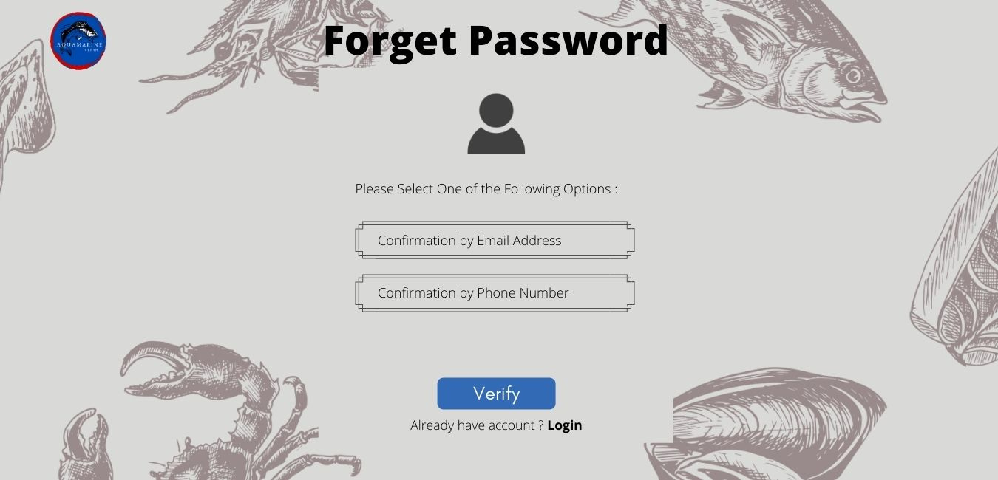
Halaman Forget Password

Slide 31
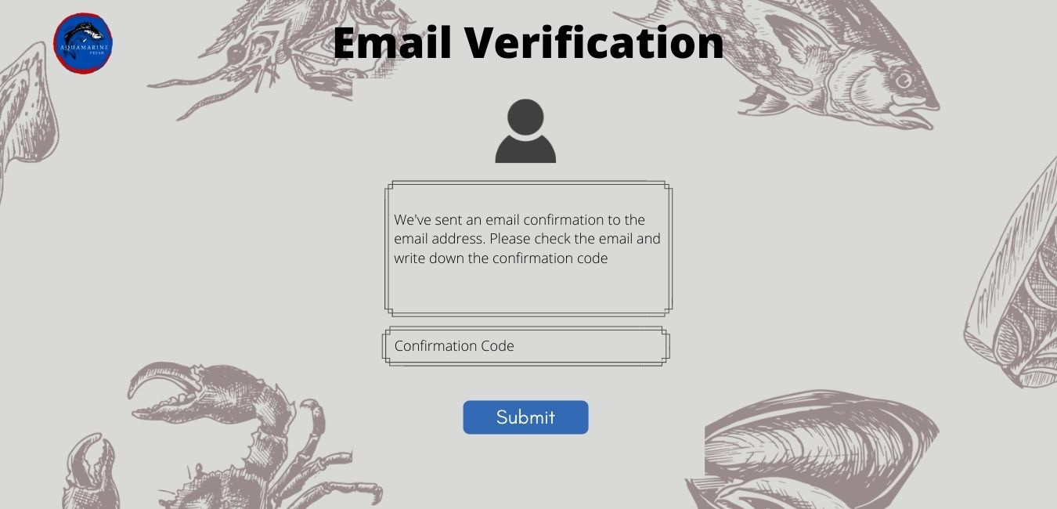
Halaman Email Verification

Slide 32
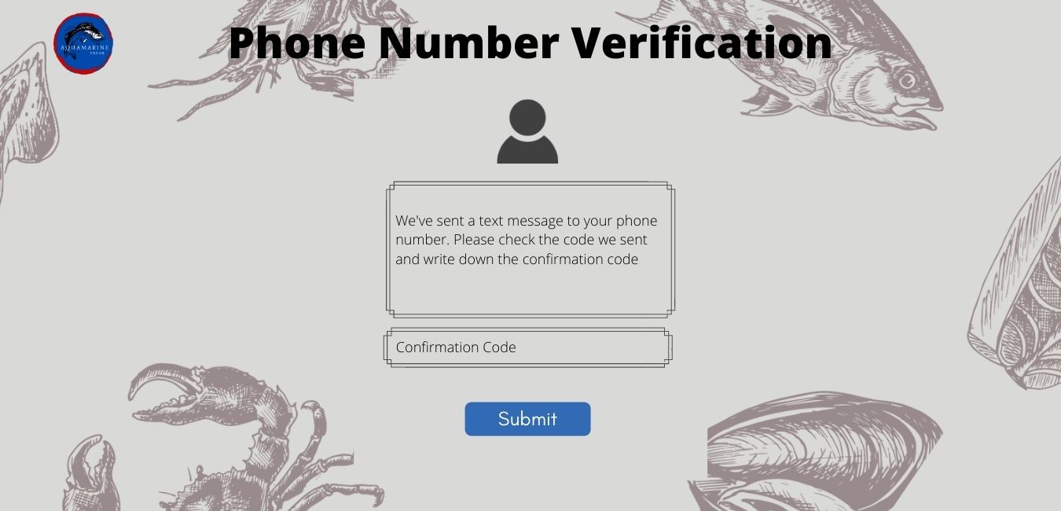
Halaman Phone Verification

Slide 33
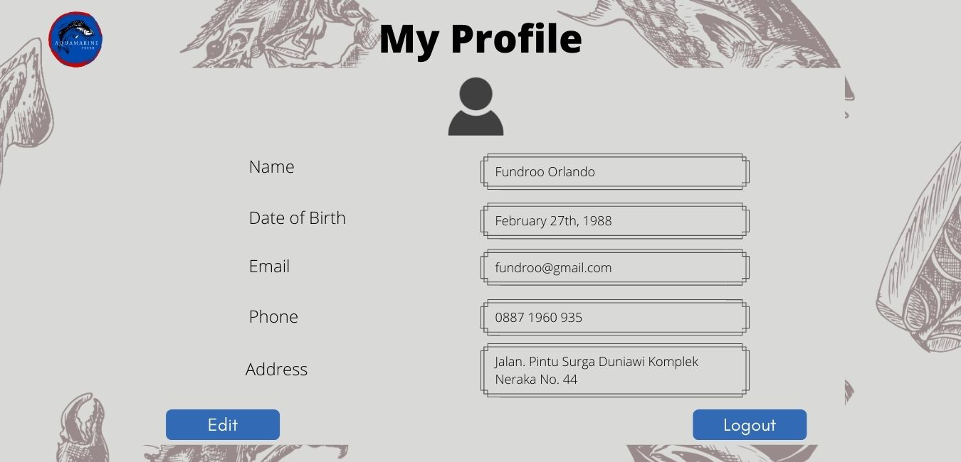
Halaman My Profile

Slide 34
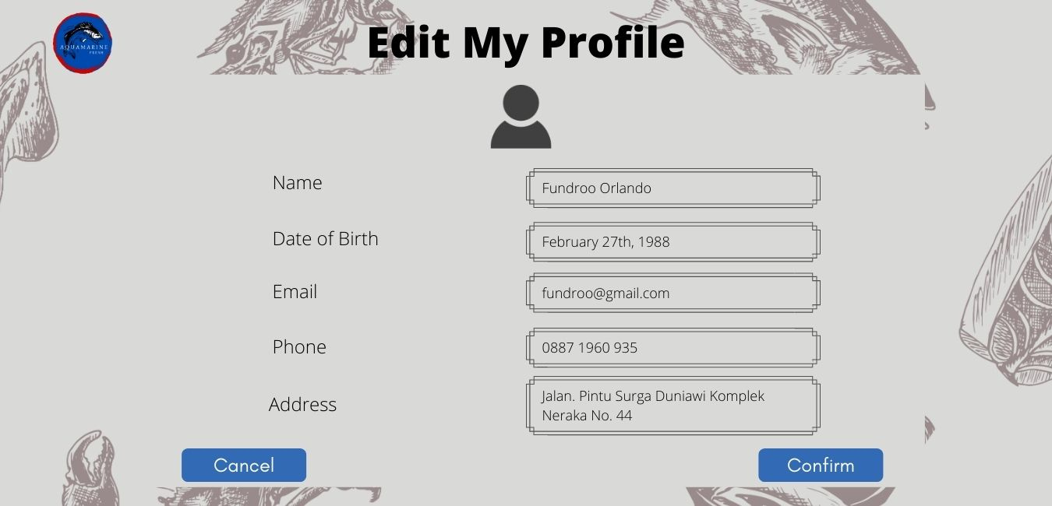
Halaman Edit My Profile

Slide 35
03
alur proses perpindahan halaman

Slide 36




NAVIGATION BAR
01
NAVIGATION BAR
02
Click HOME
to Home section
Click CATEGORIES
to Categories section
Click PRODUCTS
to PRODUCTS section
Click ABOUT US
to ABOUT US section
NAVIGATION BAR
03
04
SEARCH BAR
Click GALLERY
to GALLERY section
Click CONTACT US
to CONTACT US section
Click Search
type Something

Slide 37
05
06
CART
PROFILE
Click Profile icon
if (haventLogin()) then
choose Login or Sign Up
if (Login) then
to Login (new page)
else
to Sign Up (new page)
else
choose My Profile or Logout
if (My Profile) then
to My Profile (new page)
else
return to Home
Click Cart icon
to Cart (new page)
07
08
SLIDESHOW
MENU BAR
Click Slideshow
to Products List (new pages)
if (clickNextIcon) then
to New Slideshow
Click Menu Bar
show Navigation Bar

Slide 38
CONTACT US
PRODUCTS
09
10
Click on Instagram
Link to Instagram Page
Click on Email
Mail to Email Address
Click Product
to Product Details (New Pages)
PRODUCT DETAILS
PRODUCT DETAILS
11
12
Click Search
type Something
Click -
Quantity decrease
Click +
Quantity increase
Click Buy Now
to Checkout (new pages)

Slide 39
PRODUCTS LIST
CART
Click Search
type Something
Click Product
to Product Details
Click Love Icon
add to Wish List
13
Click on The Product
to The Product Details
Click on Love Icon
add to Wish List
Click X Icon
remove from Cart
14
CART
15
CART
16
Click v
adjust Quantity
Click Continue Shopping
to Products List (new pages)
Click wish list
to Wish List (new page)
Click Checkout
to Checkout Page

Slide 40
WISH LIST
Click The Product
to The Product List
Click + Icon
add to Cart
Click X Icon
remove from Wish List
17
WISH LIST
18
Click v
adjust Quantity
Click Add all to Cart
empty Wish List
CHECKOUT
19
20
PAYMENT
Click Change Information
to Edit My Profile (new page)
Click Checkout
to Payment (new page)
Click E-Money
choose option
Click Credit Card
choose option

Slide 41
21
22
PAYMENT
LOGIN
Click Bank Transfer
choose option
Click Submit
back to Checkout (new page)
Click Enter your username or email address
type Something
Click Password
type Something
LOGIN
SIGN UP
23
24
Click Login
back to Home
Click Click here
to Forget Password (new pages)
Click Sign Up
to Sign Up (new pages)
Click Username
type Something
Click Email address
type Something

Slide 42
SIGN UP
SIGN UP
25
26
Click Password
type Something
Click Confirm your password
type Something
Click Full Name
type Something
Click Phone Number
type Something
SIGN UP
SIGN UP
27
28
Click Region
choose Region
Click Full Address
type Something
Click Sign Up
back to Home
Click Login
to Login (new pages)

Slide 43
FORGET PASSWORD
FORGET PASSWORD
29
30
Click Enter your username
type Something
Click Enter your email address
type Something
Click Enter your last password
type Something
Click Enter your phone number
type Something
32
FORGET PASSWORD
FORGET PASSWORD
Choose Confirmation by Email Address or Confirmation by Phone Number
if (Confirmation by Email Address) then
confirmation code will be send by Email
if (Confirmation by Phone Number) then
confirmation code will be send by Message
31
Click Verify
to Forget Password (new page (another))
Click Login
to Login (new pages)

Slide 44
FORGET PASSWORD
EMAIL VERIFICATION
33
Click Verify
to verify choose either Email Address
or Phone Number
Click Login
to Login (new pages)
34
Click Confirmation Code
type Something
Click Submit
back to Home
PHONE NUMBER VERIFICATION
MY PROFILE
35
36
Click Edit
to Edit My Profile
Click Log Out
back to Home
Profile will be log out
Click Confirmation Code
type Something
Click Submit
back to Home

Slide 45

EDIT MY PROFILE
37
38
EDIT MY PROFILE
Click box
type something
Click Cancel
back to My Profile (new page)
39
EDIT MY PROFILE
Click Confirm
back to My Profile (new page)
My Profile change
AQUAMARINE

Slide 46

Thank You

